Slide 1
Section 4.1
The Derivative in Graphing and Applications- “Analysis of Functions I: Increase, Decrease, and Concavity”

Slide 2
All graphics are attributed to:
Calculus,10/E by Howard Anton, Irl Bivens, and Stephen Davis Copyright © 2009 by John Wiley & Sons, Inc. All rights reserved.

Slide 3
Overview
In this chapter, we will study a variety of applications of the derivative.
Analyzing graphs
Optimization problems to find the smallest and largest value occurs
Motion of a particle along a line

Slide 4
Analyzing Graphs
Some problems require more precision than graphing calculators produce. Therefore, we need methods to determine the exact shape of a graph and locations of key features.

Slide 5
Increasing, Decreasing and Constant Functions/Intervals
A differentiable function (one you are able to take the derivative of) is increasing on any interval where each tangent line to its graph has a positive slope.
A differentiable function is decreasing on any interval where each tangent line to its graph has a negative slope.
A differentiable function is constant on any interval where each tangent line to its graph has a zero slope.
See graphs on next page to help visualize.

Slide 6
Graphical Interpretation

Slide 7
Related Theorem
Note: The derivative conditions are only required to hold inside the interval (a,b), even though the conclusions apply to the entire interval [a,b].

Slide 8
Example
Find the intervals where the graph of
is increasing, decreasing, and/or constant.
Solution: By differentiating f(x), we obtain
Then do the zero product property which gives x=0, x=-2 and x=1. Since f’(x) =0 at these points, that is where the function is constant (these are called stationary points).
Next, we need to make an interval table to find out where it is increasing and/or decreasing.

Slide 9
Interval Table and Graph
Interval | Test # | Test in f ’(x) | Result | Effect
(-infinity, -2) | -3 | 12(-3)³+12(-3)²-24(-3) | -144 | decreasing
(-2, 0) | -1 | 12(-1)³+12(-1)²-24(-1) | +24 | increasing
(0, 1) | .5 | 12(.5)³+12(.5)²-24(.5) | -7.5 | decreasing
(1, +infinity) | 2 | 12(2)³+12(2)²-24(2) | +96 | increasing
We can see the results of the zero product property and the interval table match the intervals on the graph where it is increasing, decreasing, and/or constant.

Slide 10
Concavity
The sign of f’(x) reveals where the graph of f(x) is increasing or decreasing or constant, it does not reveal direction of curvature a.k.a. concavity.
For that we will need the second derivative because a function is “concave up” on an open interval (a,b) if its graph lies above its tangent lines and is “concave down” if its graph lies below its tangent lines.

Slide 11
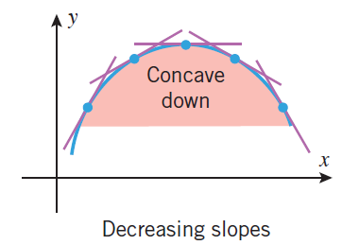
Visual Interpretation
Slopes are getting bigger as you move to the right.
Slopes are getting smaller as you move to the right

Slide 12
How to find intervals of concave up and concave down
A differentiable function is concave up on any interval where f’’(x) is positive.
A differentiable function is concave down on any interval where f’’(x) is negative.

Slide 13
Inflection Points
A differentiable function has an inflection point where the second derivative is zero.

Slide 14
Previous Example Continued
Find the intervals where the graph of
is concave up, concave down, and/or constant.
Remember, the first derivative was
therefore, the second derivative is f’’(x) = 36 x² + 24 x – 24.
If you factor out the 12, set it equal to zero, and do the quadratic formula for 0 = 12(3 x² + 2x - 2), you get x = .55 and x= -1.2.
Those are called the inflection points and it is where the concavity changes. To determine whether concavity is up or down, you need an interval table.
Interval | Test # | Test in f ’’(x) | Result | Effect
(-infinity, -1.2) | -2 | 36(-2)²+24*-2-24 | +72 | Concave up
(-1.2,.55) | 0 | 36(0)²+24*0-24 | -24 | Concave down
(.55, +infinity) | 1 | 36(1)²+24*1-24 | +36 | Concave up

Slide 15
Graph
We can see the results of the quadratic formula and the interval table match the intervals on the graph where it is concave up, concave down, or has an inflection point.

Slide 16
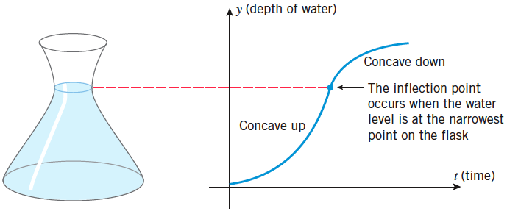
Inflection Points in Applications
Inflection points mark the places on the curve f(x) where the rate of change of y with respect to x changes from increasing to decreasing or vice versa.

